Slide 1


Signals and Image
Processing
Group 2
Mariam Magdy 1000659
Ahmed Elaraby 1002199
Omar Fadel 1002097
Farida Helaly 1000960
Omar Ashraf 1001942
Youssef Sameh 1001681

Slide 2


Content
1
Introduction
2
Milestone 2 Overview
3
Milestone 4 Overview

Slide 3
1. Introduction
Two techniques for traffic sign detection
Classical Image Processing Methods
Deep Learning

Slide 4
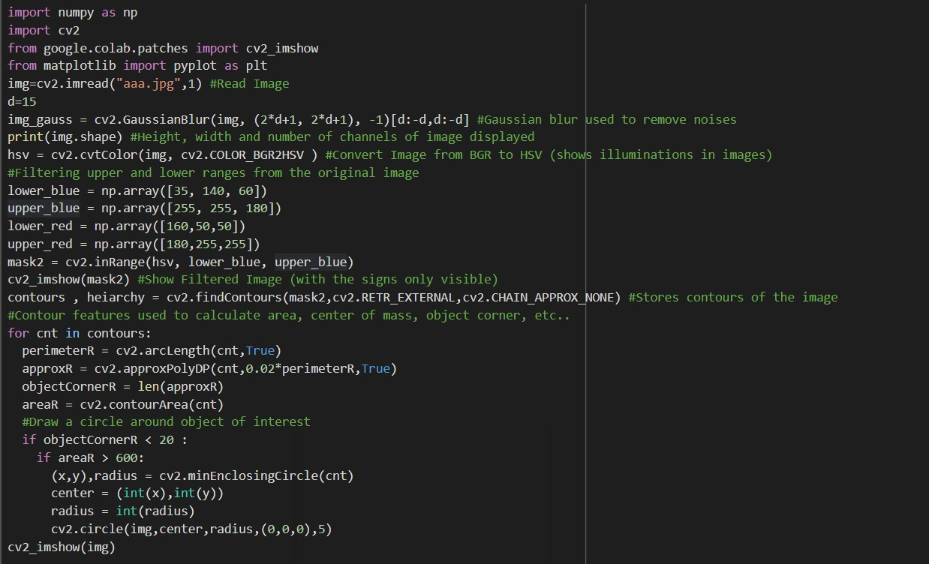
2.Milestone 2 Overview
Notes:
小芥末素材 rosyhouse.taobao.com

Slide 5
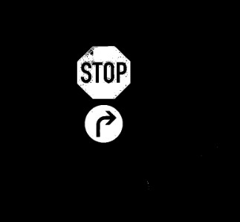
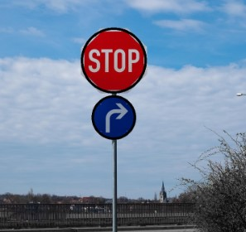
Results
Filtered image with signs only visible
Final Output

Slide 6
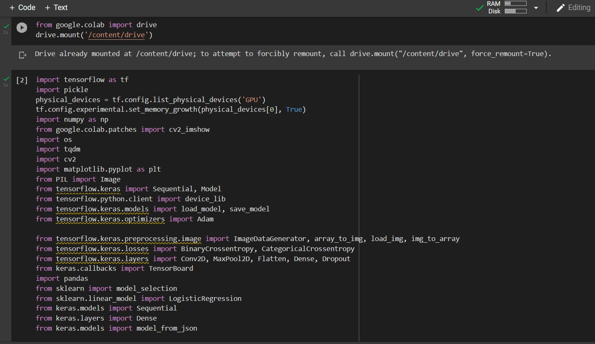
3.Milestone 4 Overview

Slide 7
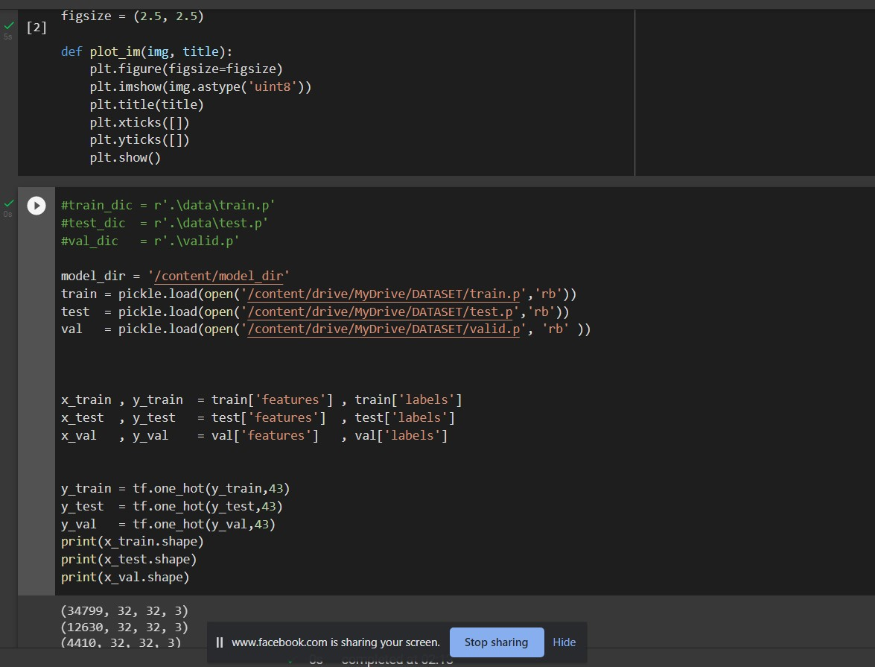
Notes:
小芥末素材 rosyhouse.taobao.com

Slide 8
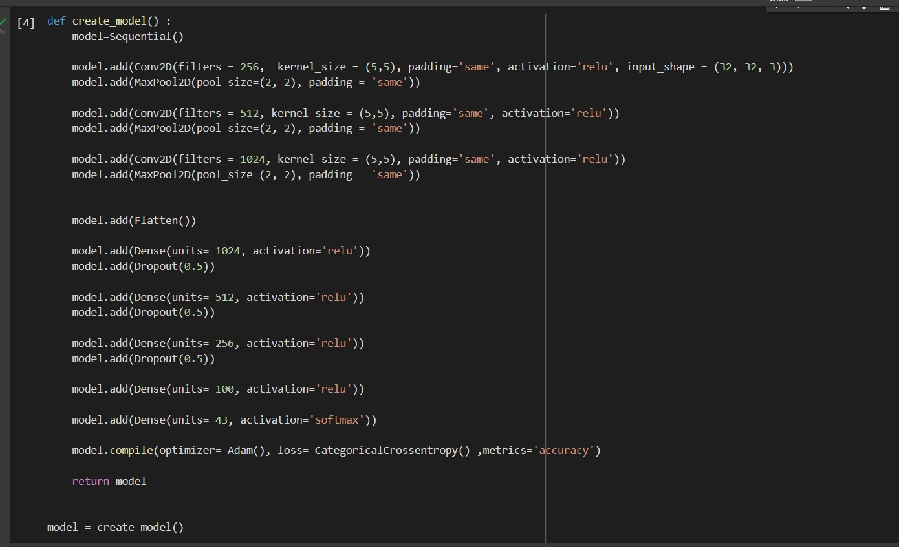
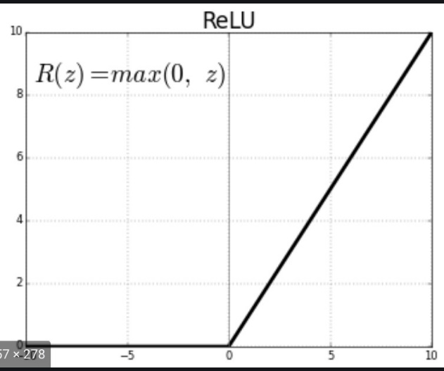
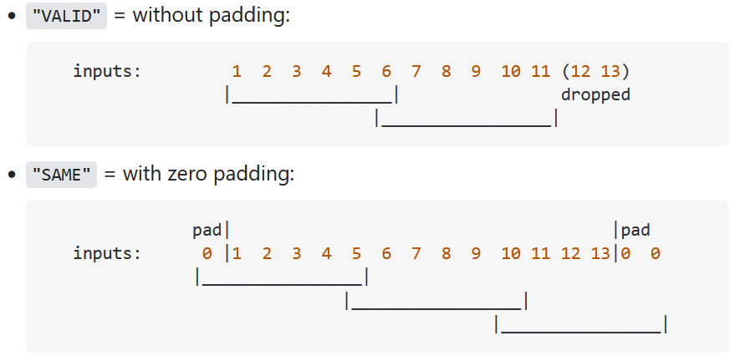
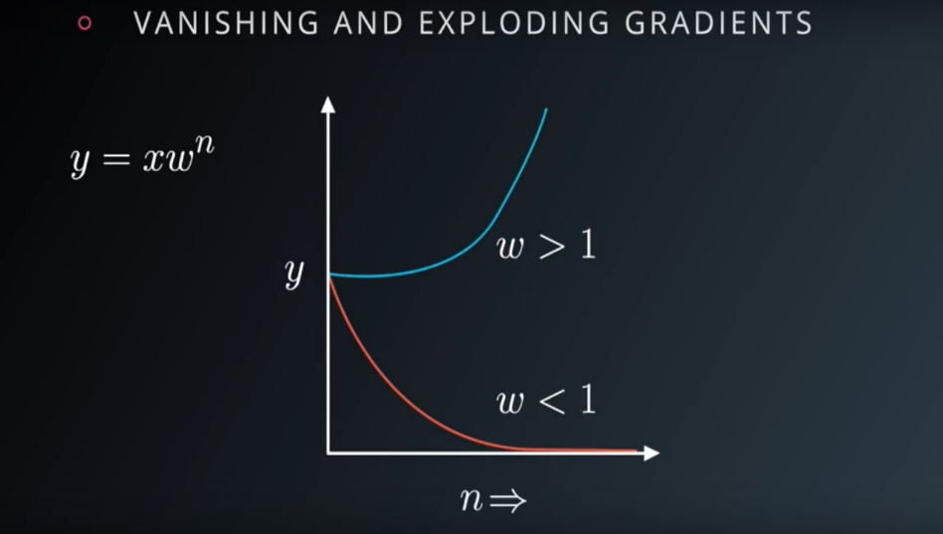
ReLU is simple to compute and has a predictable gradient for the backpropagation of the error.
We didn't use Sigmoid or tanH due to exploding and vanishing gradients and not zero centered
Notes:
小芥末素材 rosyhouse.taobao.com

Slide 9
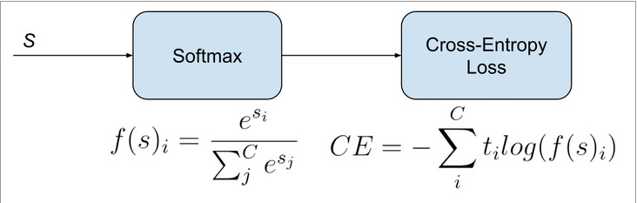
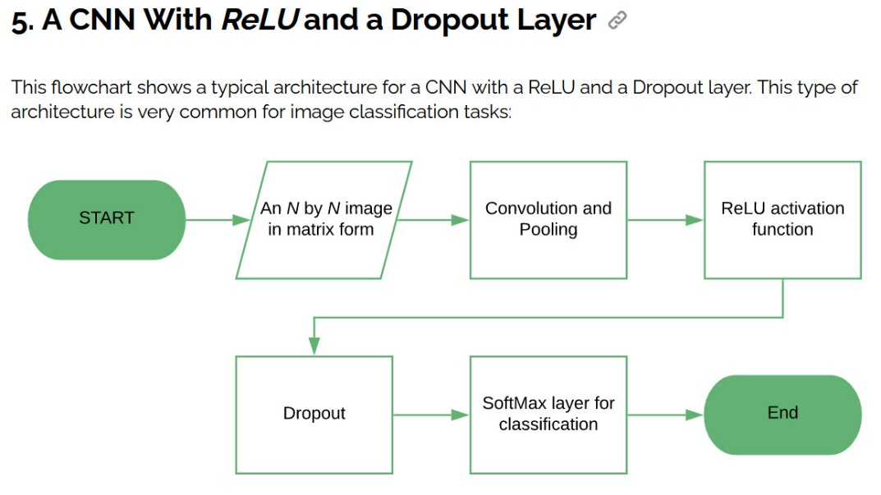
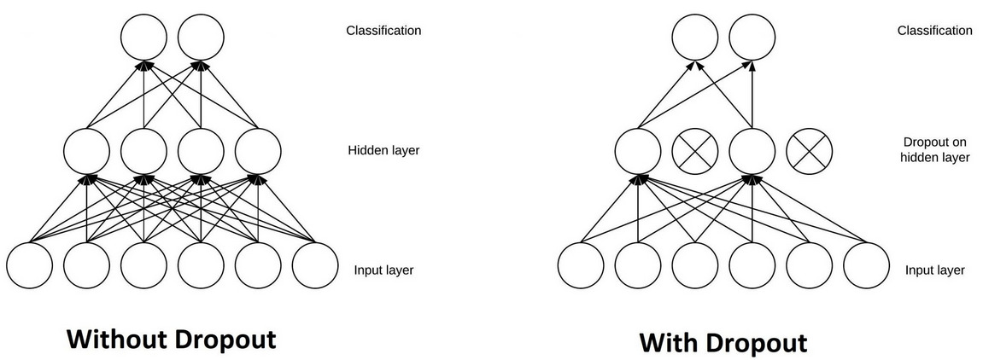
Dropout layers are important in training CNNs because they prevent overfitting on the training data.
Notes:
小芥末素材 rosyhouse.taobao.com

Slide 10
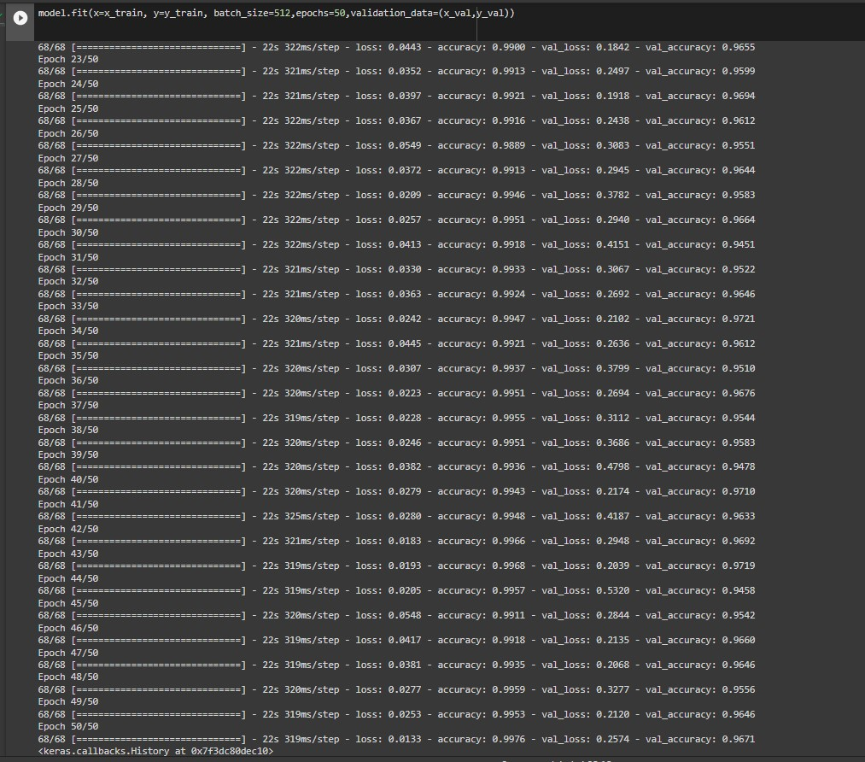
Notes:
小芥末素材 rosyhouse.taobao.com

Slide 11
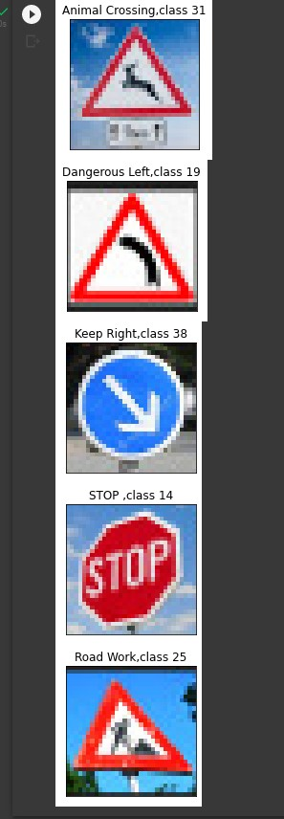
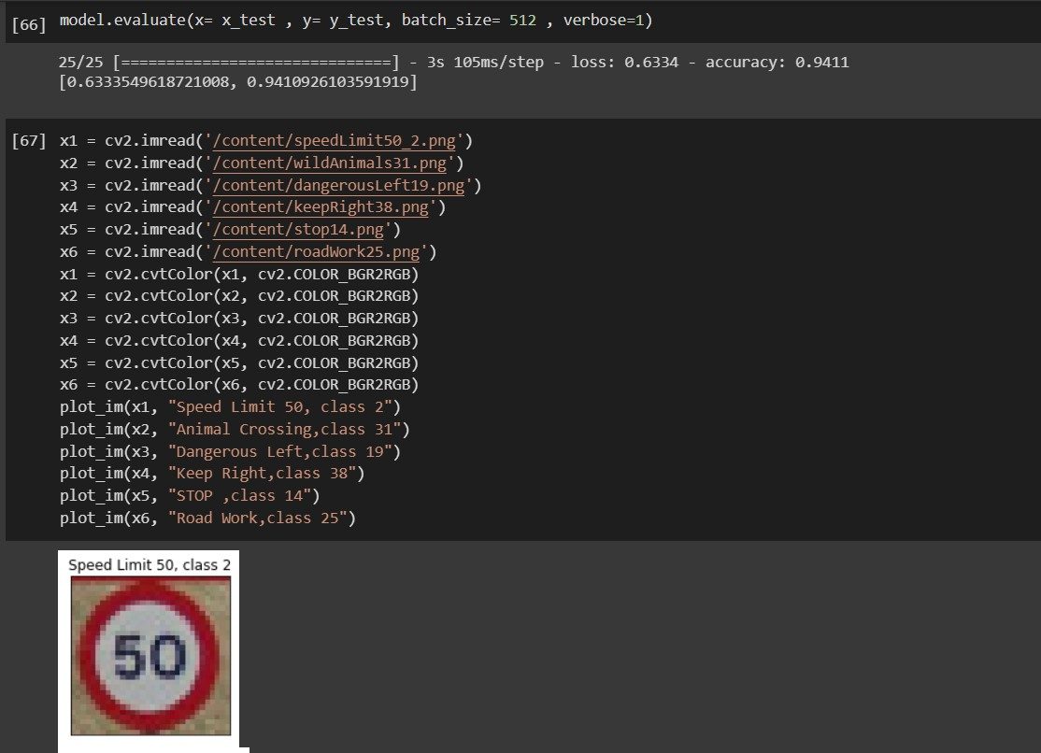
Notes:
小芥末素材 rosyhouse.taobao.com

Slide 12
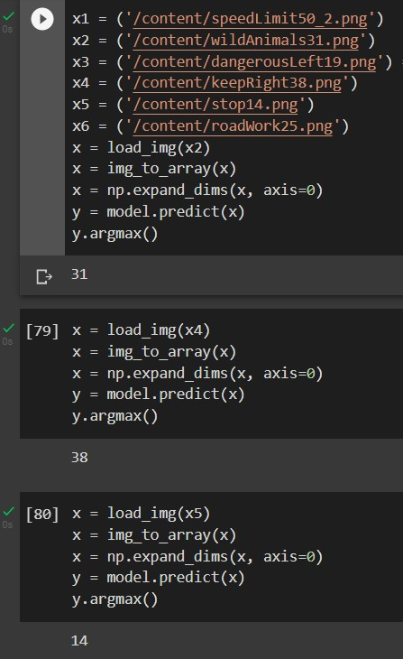
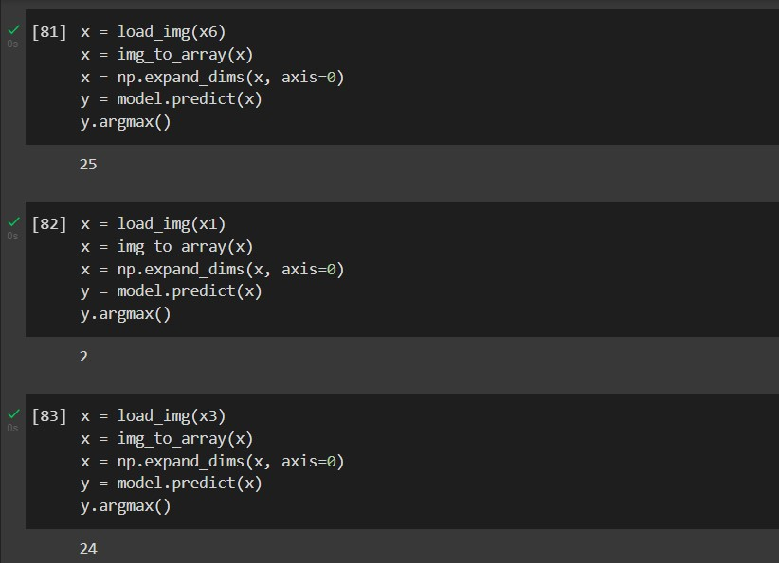
Notes:
小芥末素材 rosyhouse.taobao.com

Slide 13
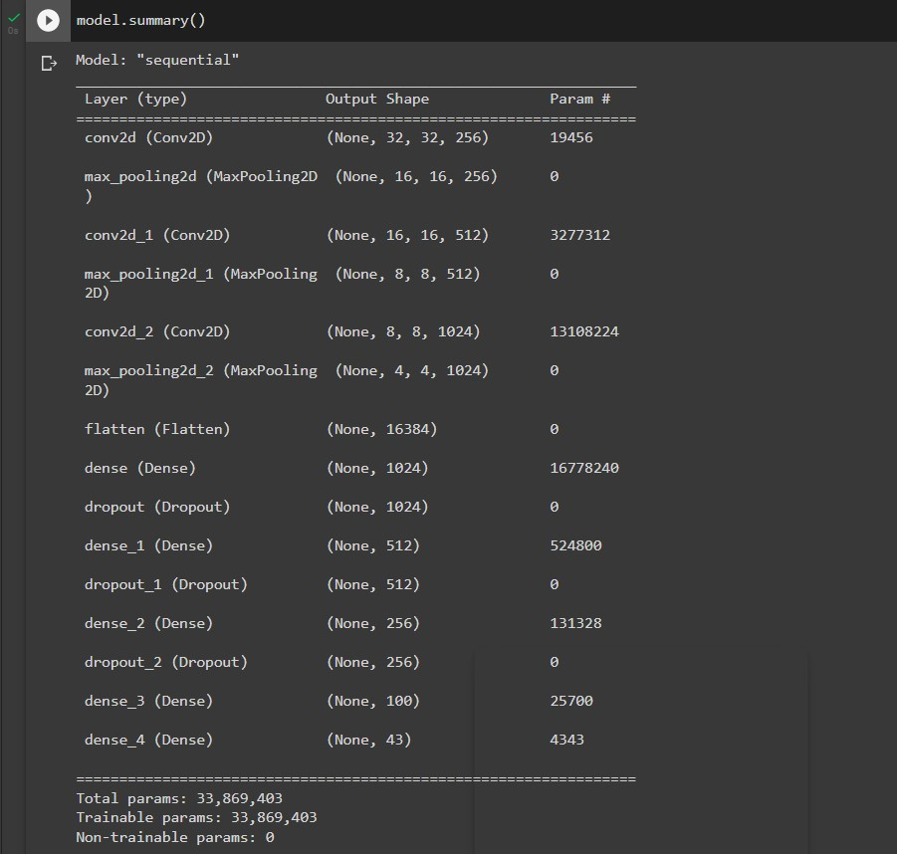
Notes:
小芥末素材 rosyhouse.taobao.com

Slide 14
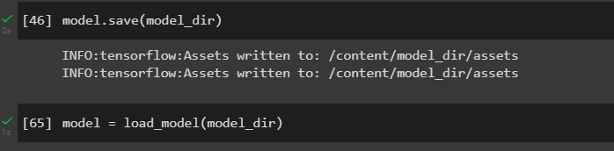
Notes:
小芥末素材 rosyhouse.taobao.com

Slide 15
Thank you ☺
Any Questions?
Notes:
我图网旗舰店，为梦想积攒力量！ https://meilechen.tmall.com

